Slide 1
Gapminder Dataset Project
This Shiny web application is designed to visualize data from the Gapminder dataset. The Gapminder dataset contains socio-economic indicators for various countries over time, including variables like life expectancy, GDP per capita, and population.

Slide 2
Introduction
The application is built using the Shiny library in R, which allows for the creation of interactive web applications.
The app has a user-friendly interface with a navigation bar at the top, allowing users to switch between two main pages: "Charts" and “Description.“
The application uses the "ggplot2" library to create visually appealing and informative charts. The "theme_minimal()" theme is applied to all charts, giving them a clean and modern look.

Slide 3
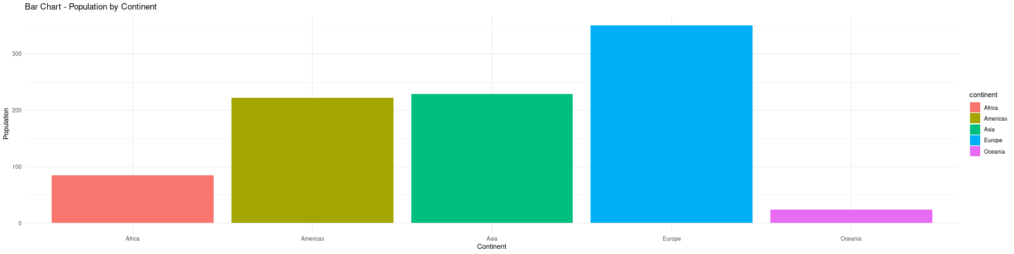
Bar Chart: This chart displays the population of different continents. Each continent is represented by a coloured bar, and the height of the bar represents the population.

Slide 4
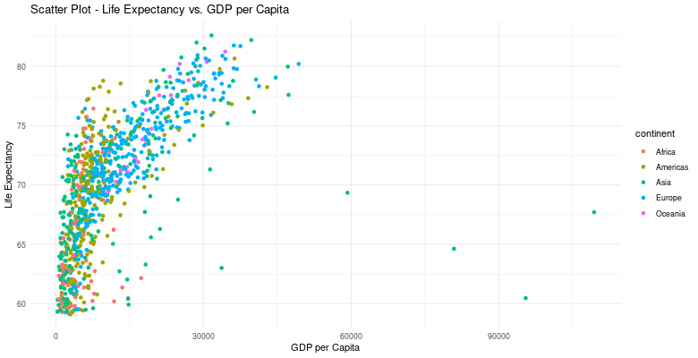
Scatter Plot: This chart shows the relationship between life expectancy and GDP per capita for different countries. Each country is represented by a point on the scatter plot, and the color of the point corresponds to its continent.

Slide 5
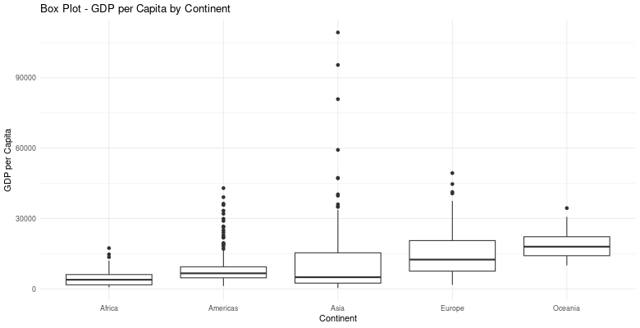
Box Plot: This chart displays the distribution of GDP per capita for different continents. Each continent is represented by a box plot, showing the median, quartiles, and outliers of GDP per capita.

Slide 6
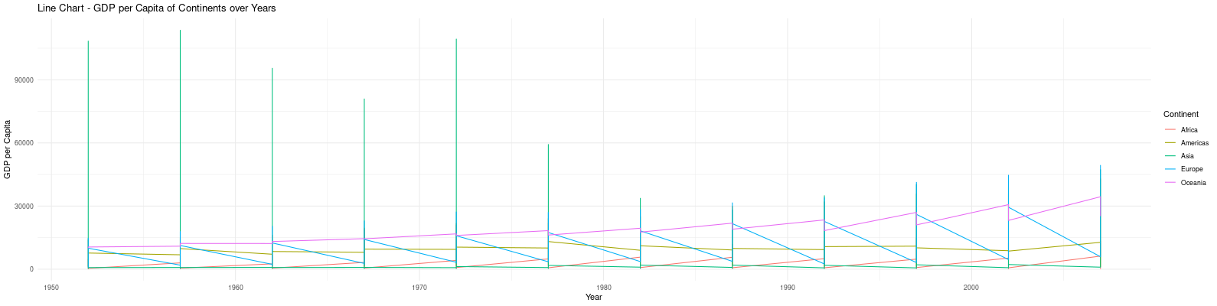
Line Chart: This chart illustrates the trend of GDP per capita over the years for different continents. Each continent is represented by a different colored line, allowing users to compare the economic growth of continents over time.

Slide 7
Conclusion
The interactivity is achieved through the use of reactive functions in the server logic. When users interact with the slider input to set the life expectancy value, the charts and the continent table are updated dynamically to show the relevant data.
Overall, the app provides an intuitive and interactive platform for users to explore and gain insights from the Gapminder dataset, making it a useful tool for data visualization and analysis.

Slide 8
Thank You !

